Slide 1
NETHERLANDS WEB-PROJECT

Slide 2
Agenda
Quick Summary
Technologies Used
Tutorial of the webpage
Problems during the project

Slide 3
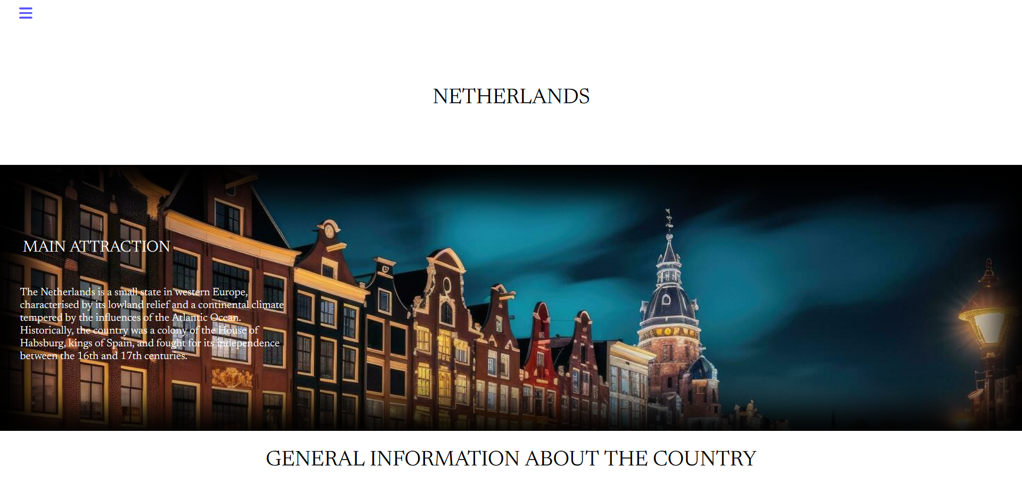
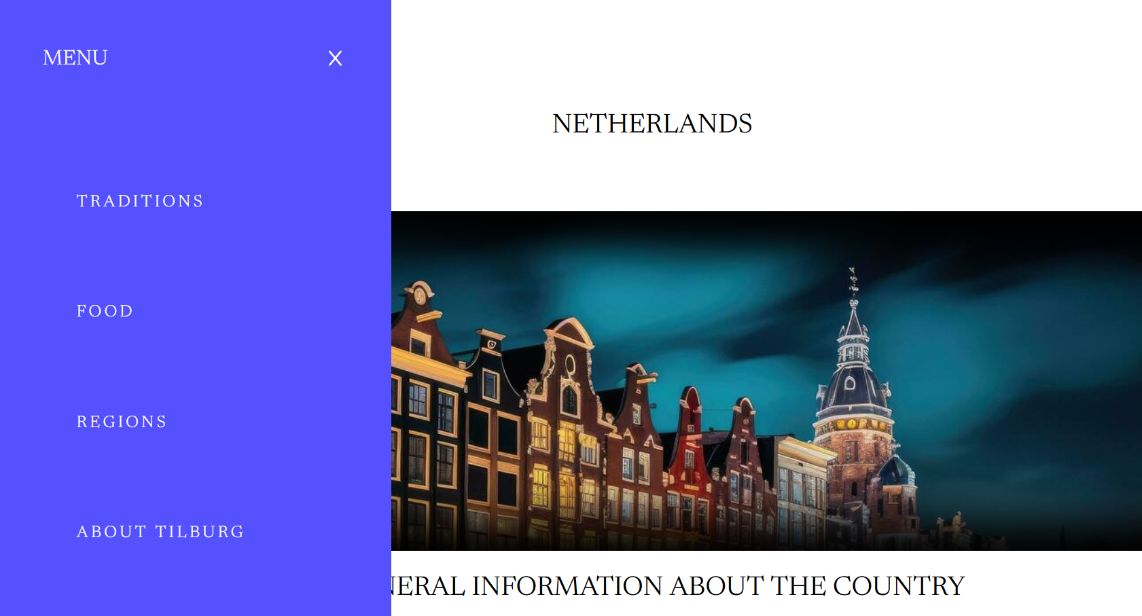
Quick Summary
The website provides an overview of the Netherlands, highlighting its history, geography, economy, and security. Through the sidebar, users can access specific sections of the site, including:
TRADITIONS: Information on the cultural traditions of the Netherlands.
FOOD: Details on the country's gastronomy.
REGIONS: Descriptions of the different regions of the Netherlands.
ABOUT TILBURG: Information about the city of Tilburg.
This structure allows visitors to explore different aspects of the Netherlands in an organised and accessible way.

Slide 4
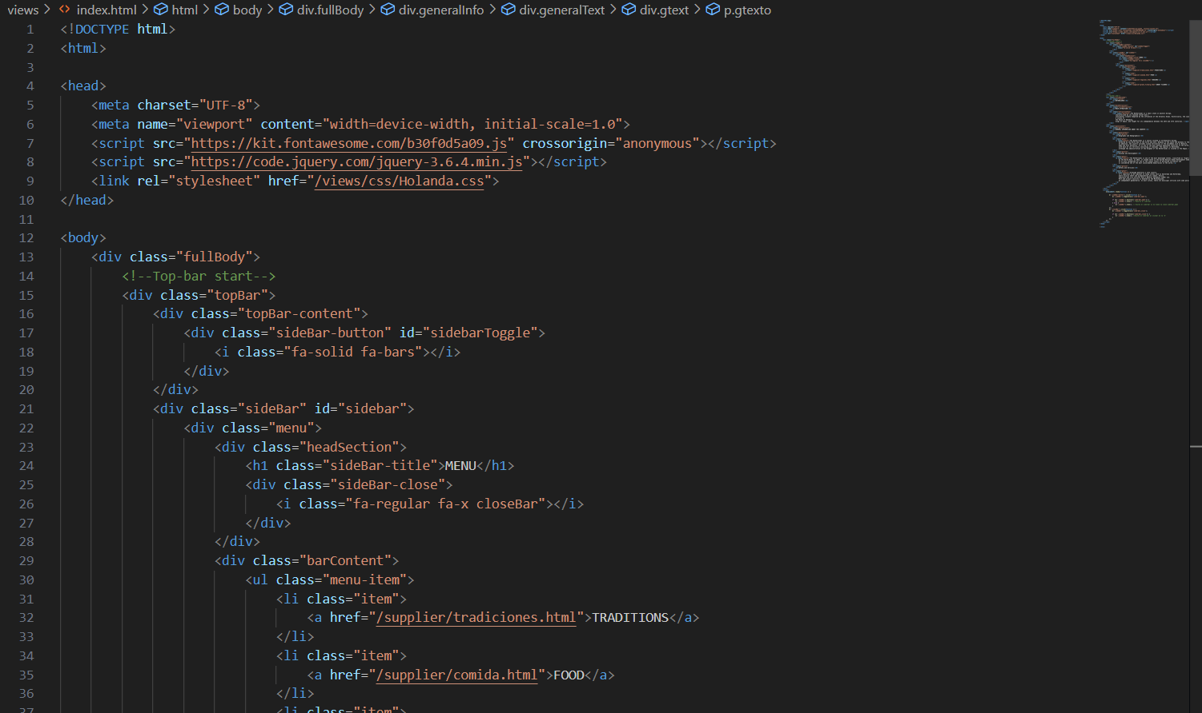
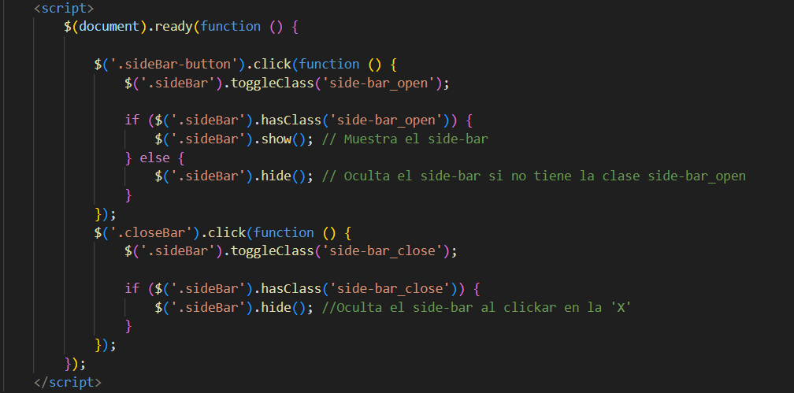
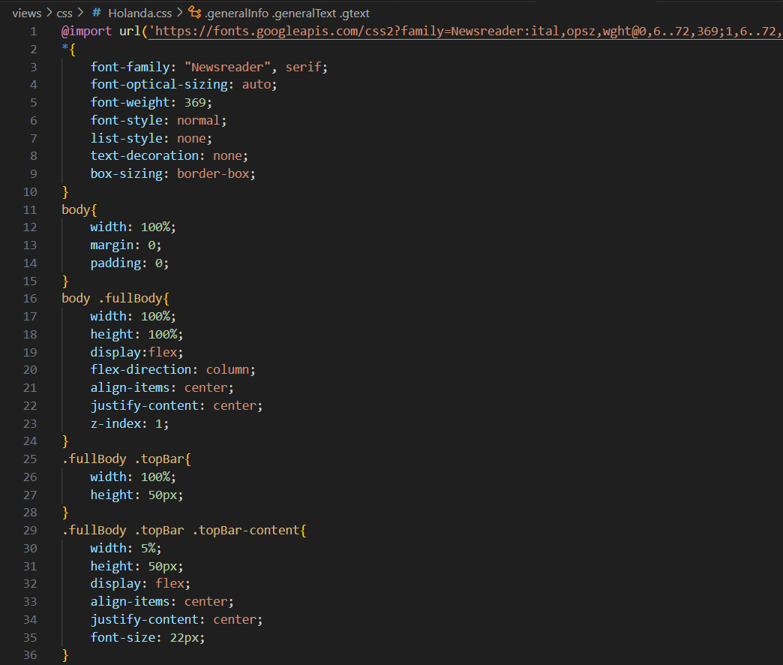
Technologies Used
The code provided uses a combination of core web development technologies, including HTML, CSS, and jQuery.

Slide 5
Tutorial
Use the side navigation bar: Click on the bars icon (☰) in the top left corner to open the side navigation bar.
Select a section: In the side navigation bar, select one of the available options:
TRADITIONS: To learn about the cultural traditions of the Netherlands.
FOOD: To learn more about the country's gastronomy.
REGIONS: To explore the different regions of the Netherlands.
ABOUT TILBURG: For information about the city of Tilburg.
Close the side navigation bar: To close the side navigation bar, click on the 'X' in the top right corner of the sidebar.
Explore the content: Browse the sections of the site for detailed information about the Netherlands, including its history, geography, economy, and security.
Navigating our website is very simple. By following the next instructions you will be able to access our contents.
-

Slide 6
Tutorial

Slide 7
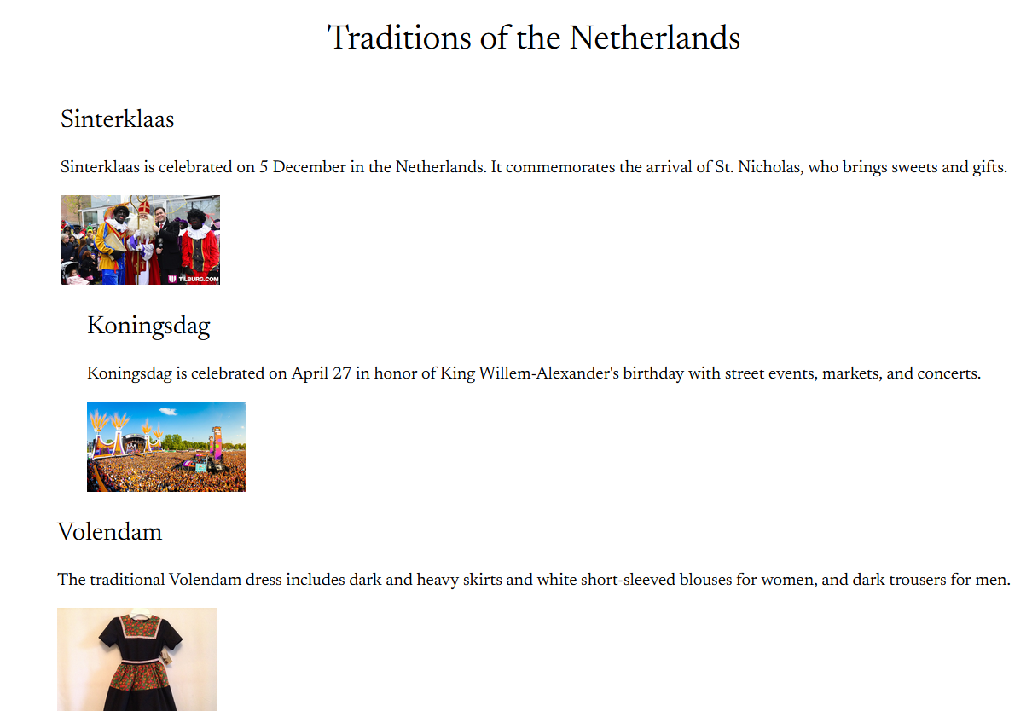
Tutorial

Slide 8
Poblems during the project
One of the problems we’ve had during the Project, was setting up the side-bar functionality.
Another problem was GitHub, at the time of creating the branches for our project we were constantly getting errors, but when we looked on the internet for the solution there was no problem.
And finally when it comes to placing things on the website (using css) in the most appropriate way for our Figma templates.

Slide 9
THAT WOULD BE ALL . THANKS FOR YOUR TIME!

